Slide 1
Benchmarking conntrack
NetFilter Workshop
Joe Stringer
2015-06-24

Slide 2
Benchmarks
Metrics
Connections per second (TCP_RR/CRR)
Cycles per connection (perf stat)
Comparison
Base figures, ipt/nft/ovs
Use cases
Tools

Slide 3
Test Environment
br/ovs/ipt/nft
Source
Linux-3.13
10G: Intel X540
Transit
Linux-4.0
10G: BCM57810
Sink
Linux-3.13
2x Intel Xeon CPU E5-2650 @ 2.00GHz

Slide 4
Methodology
Tune netfilter parameters
eg TCP_TIMEOUT_WAIT=1s
Configure setup, no more, no less
eg no nf_conntrack,netfilter_bridge for L2
Run tests (perf, netperf) for 30s, sleep 2s
6 sizes * 4 thread configurations * 3 tries

Slide 5
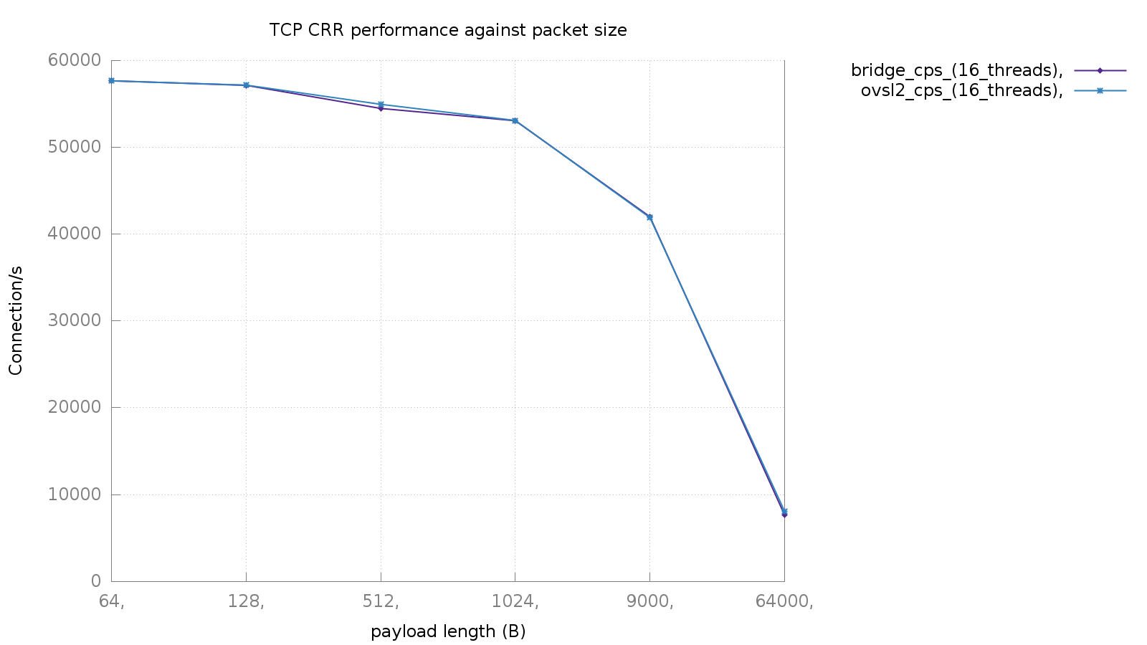
Baseline

Slide 6
Test case
Allowing 1000 IPs
But traffic isn’t matching the first 1K
Finally, apply firewall
Allow all one direction
Allow established in reverse

Slide 7
Linear chains
-A FORWARD -i p2p1 -p tcp -s 192.170.0.1 -j ACCEPT
… x1000
-A FORWARD -i p2p1 -p tcp -s 172.31.1.35 -j ACCEPT
-A FORWARD -i p3p1 -p tcp -m conntrack --ctstate ESTABLISHED,RELATED -j ACCEPT
-A FORWARD -i p3p1 -p tcp -j DROP

Slide 8
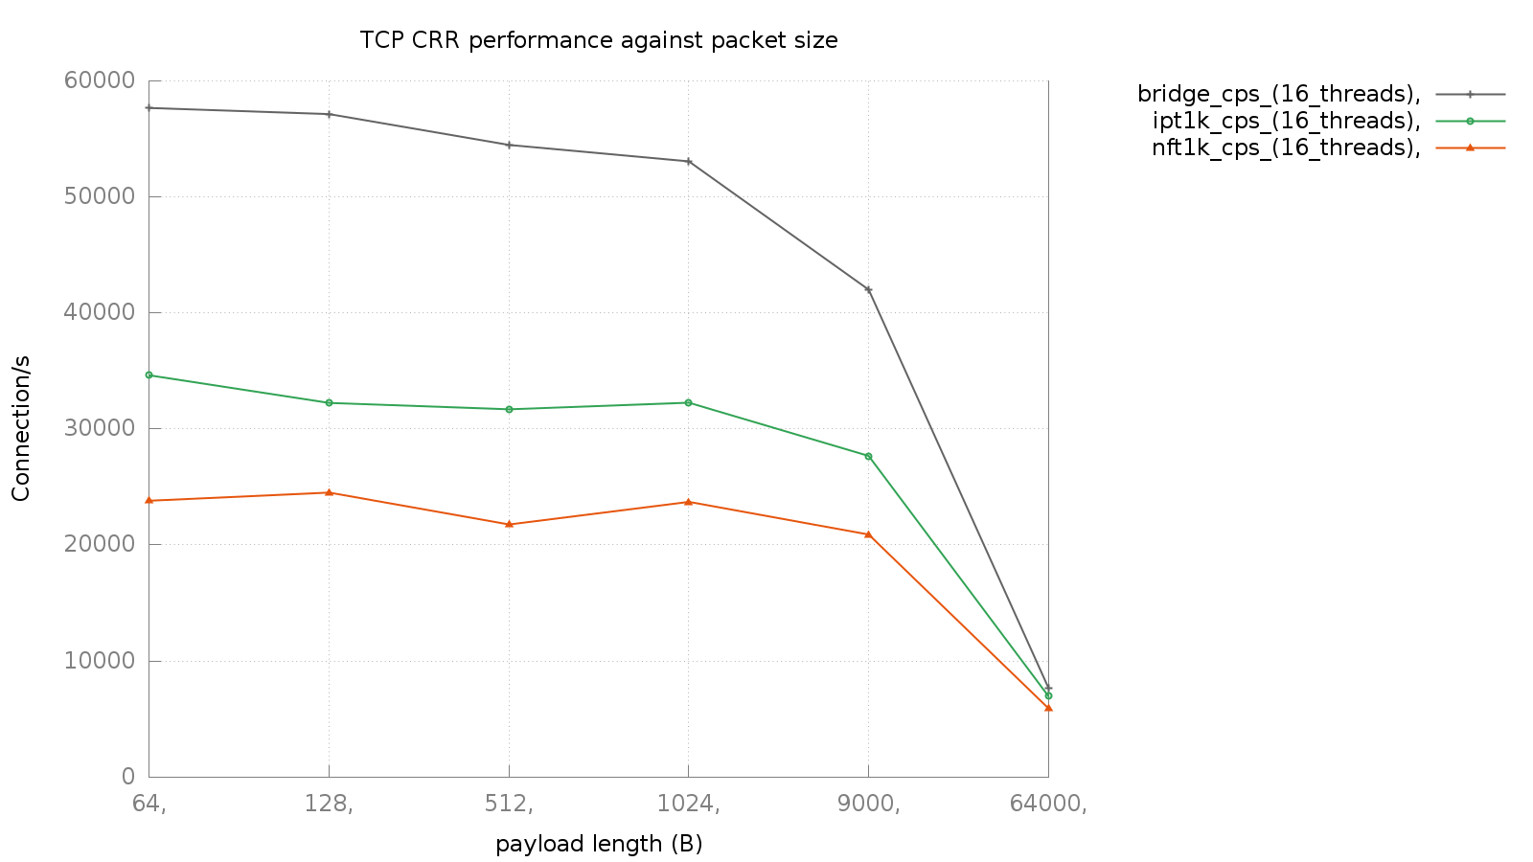
Baseline
Linear iteration

Slide 9
OK, everyone knows linear = slow
So how about the map-based approaches?
ovsct:
openvswitch with wip conntrack support
nftables:
using sets, verdict maps
ipset

Slide 10
OVS OpenFlow Rules
in_port=2,conn_state=-trk,tcp,nw_src=192.170.0.1/32, action=ct(recirc,zone=0)
in_port=2,conn_state=+trk,tcp,nw_src=192.170.0.1/32, action=ct(commit,zone=0),1
in_port=1,conn_state=-trk,tcp,nw_dst=192.170.0.1/32, action=ct(recirc,zone=0)
in_port=1,conn_state=+trk+est-new,tcp,nw_dst=192.170.0.1/32, action=2
in_port=1,conn_state=+trk-est+new,tcp,nw_dst=192.170.0.1/32, action=drop
…
priority=10,arp,action=normal
priority=10,icmp,action=normal
priority=1,action=drop (lowest priority)

Slide 11
Netfilter sets
table filter {
chain forward {
type filter hook forward priority 0;
iif p2p1 ip saddr @allowed ip protocol tcp accept
iif p2p1 ip saddr 172.31.1.35 ip protocol tcp accept
iif p2p2 ip saddr @allowed ip protocol tcp accept
iif p2p2 ip saddr 172.31.1.27 ip protocol tcp accept
iif p3p1 ip protocol tcp ct state established|related accept
iif p3p1 ip protocol tcp drop
}
}

Slide 12
Netfilter set elements
table filter {
set allowed {
type ipv4_addr;
elements = {
192.170.0.1,
…
}
}
}

Slide 13
Netfilter maps
table ip filter {
map allowed {
type ipv4_addr : verdict;
}
chain forward {
type filter hook forward priority 0;
iif p2p1 ip protocol tcp ip saddr vmap @allowed
iif p2p1 ip saddr 172.31.1.35 ip protocol tcp accept
iif p2p2 ip protocol tcp ip saddr vmap @allowed
iif p2p2 ip saddr 172.31.1.27 ip protocol tcp accept
iif p3p1 ip protocol tcp ct state established|related accept
iif p3p1 ip protocol tcp drop
}
}

Slide 14
Netfilter map elements
add element filter allowed {
192.170.0.1 : accept,
…
}

Slide 15
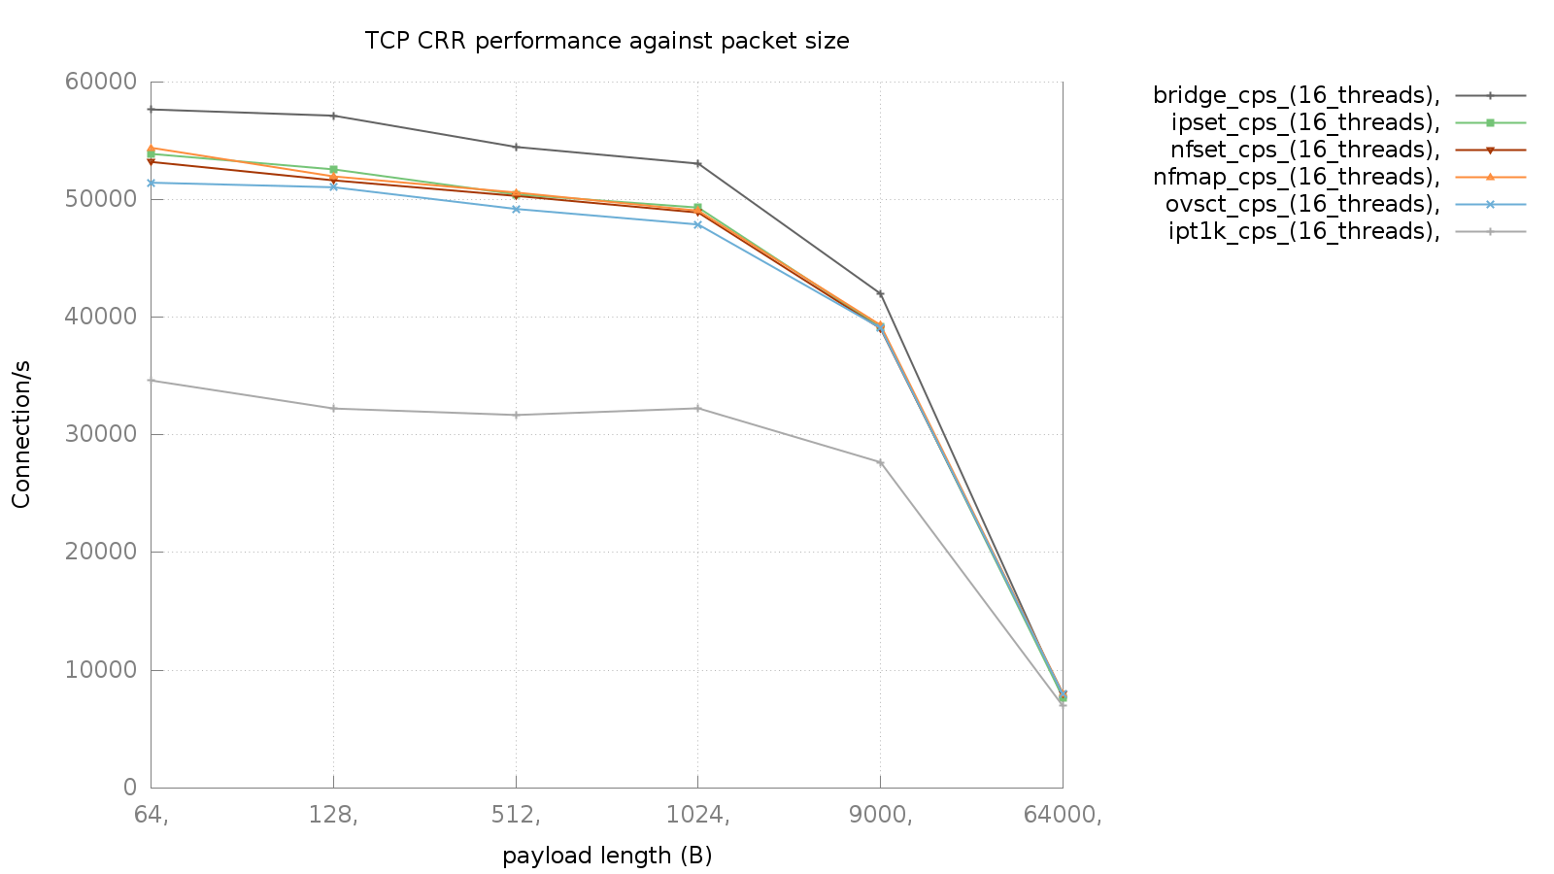
Baseline
Maps
Linear iteration

Slide 16
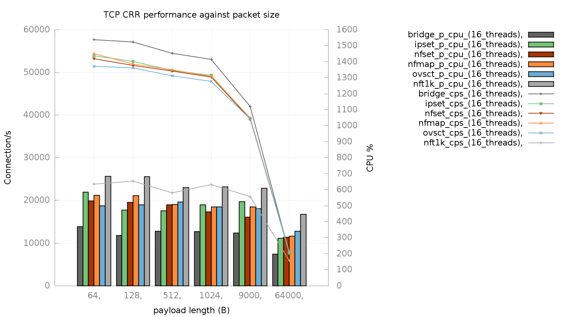

Slide 17
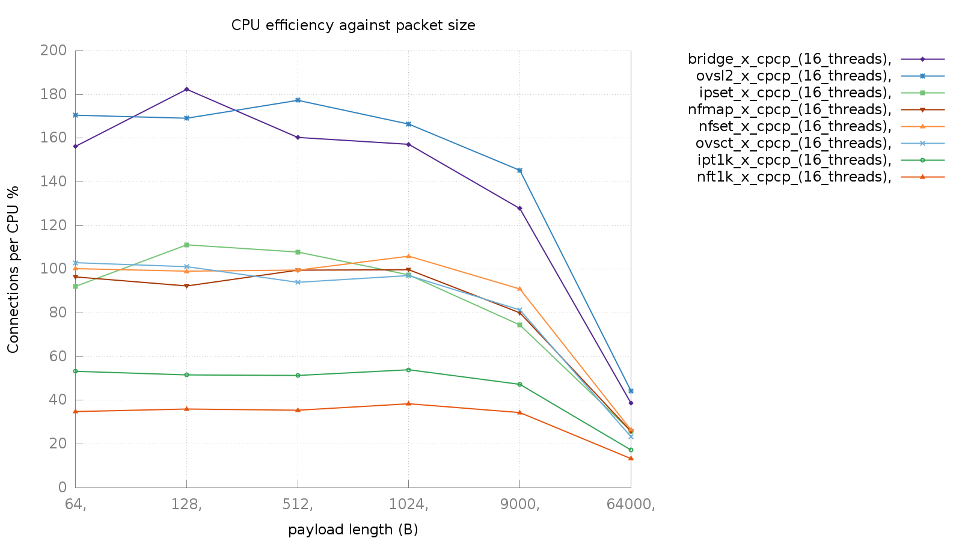
No policy enforced
Policy enforced

Slide 18
Performance Isolation
Conntrack in multi-tenant environments
If Coke gets lots of connections, ensure it doesn’t impact Pepsi
Per-zone configuration?
Connection limits
Timeouts
Ratelimiting

Slide 19
Sources
Linux 4.0.5 from kernel.org
nftables, libnftnl git @ 2015-06-06
https://github.com/justinpettit/ovs conntrack
http://people.netfilter.org/kadlec/nftest.pdf
super_netperf and friends
https://github.com/joestringer/ct_perf

Slide 20
Thank You
joestringer@nicira.com

